Slide 1
Getting started with SharePoint Framework
Basic React web part structure

Slide 2
Agenda
How to create a React web part
Structure of the basic template
How to extend the solution
Q&A

Slide 3
How to create a React web part
Create a new web part by running the Yeoman SharePoint Generator
> yo @microsoft/sharepoint
Configure the web part information
Select the React framework
What framework would you like to start with?
No javaScript web framework
React
Knockout

Slide 4
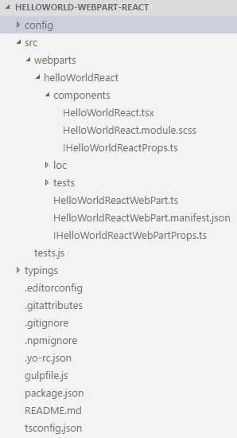
Structure of the basic template
Top level folders
config: includes all config files
src: this is the main folder of the project, it includes the web part, styles, and a test file.
typings: includes some type definition files. Most type definitions are installed in node_modules\@types

Slide 5
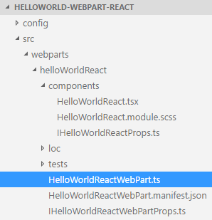
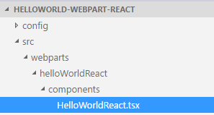
Key files – web part class
Defines the main entry point for the web part
Renders and returns the main element

Slide 6
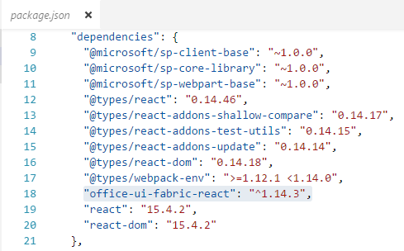
How to extend the solution
Add an Office UI Fabric component package
> npm i office-ui-fabric-react --save
After installation, the package.json file is updated.

Slide 7
DEMO
Basic React web part structure

Slide 8
Summary
How to create a React web part
Structure of the basic template
How to extend the solution
Q&A

Slide 9

Sharing is caring…
Code samples and solutions
Reusable components
Guidance documentation
Monthly community calls
SharePoint Framework
SharePoint add-ins
Microsoft Graph
Office 365 APIs
http://aka.ms/SharePointPnP

Slide 10

Q&A

Slide 11


